Slide 1
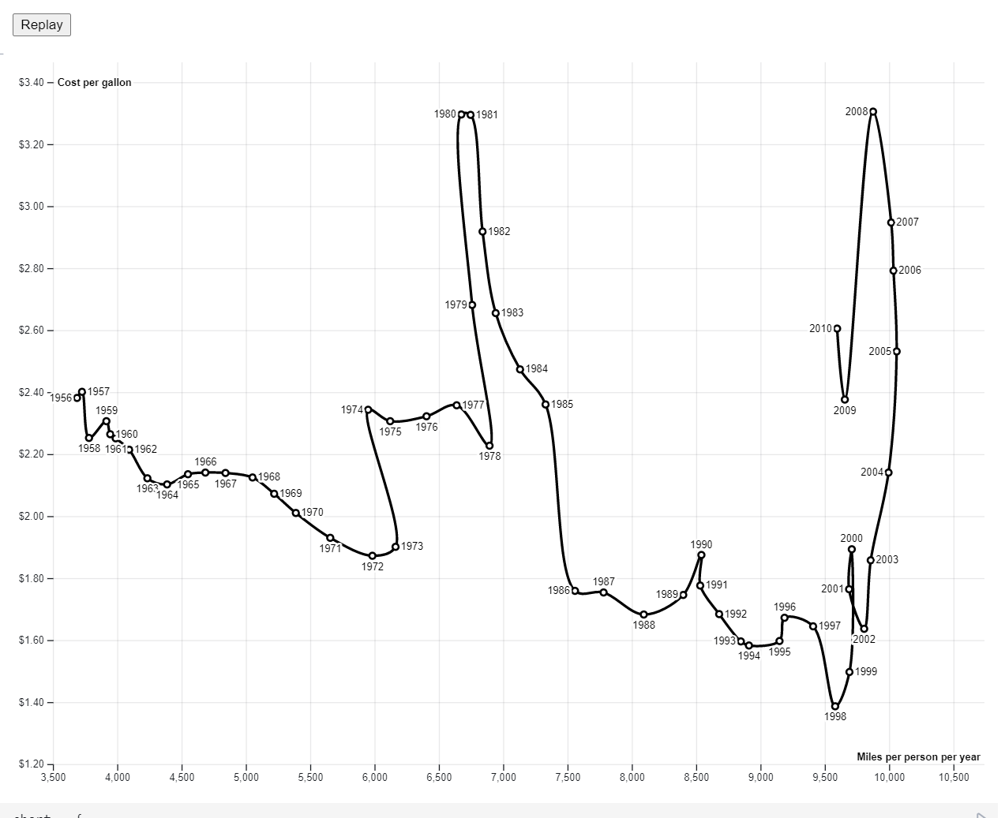
Choose File: drive.csv
1974
x-axis
y-axis
hue
chroma
Feature #11
1968
Feature #7
Feature #6
Year: 1965
MPY: 7475
CPG: $3.39
Feature #8
Feature #10
Miles Per Gallon
Miles Per Person Per Year

